Slide 1
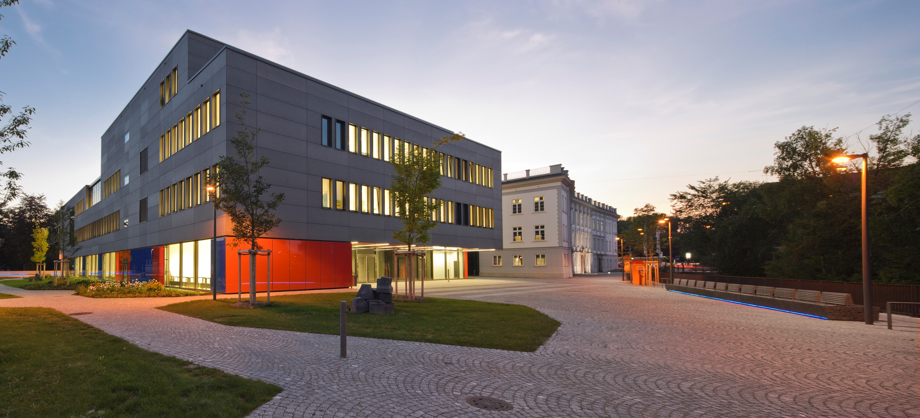
Configuration Management
Major Project, Master Industrial Security, WS2020/21
A. Holzmann , M. Kamm, M. Wager

Slide 2
Agenda
Agenda
Introduction
Analysis Phase
Concept Phase
Design Phase
Implementation Phase
Validation Phase
Summary & Outlook
A. Holzmann, M. Kamm, M. Wager – Winter Semester 2020/21
Notes:
0:45

Slide 3
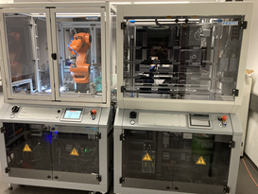
Introduction – Scenario Description
Scenario Description
Company fact sheet
• Company: Yeskia Inc.
• Yearly overall revenue: 24,700,000,000 EUR
• Relevant sector for project assignment: production of smartphone devices
• Production: 10 production lines distributed across 3 sites located in China
• Operation: 24/7 - 365 days per year
• Product name: A-Phone
• Yearly revenue: 8,300,000,000 EUR
• Selling price: 899 EUR per device
• Manufacturing material costs: 249 EUR per device
• Units produced: 9,232,480 per year
• Basic production costs: 50,000,000 EUR per line per year (labor, production infrastructure)
Virtual emulation of a real world scenario
Laboratory production facility represents system test and customer environment
Figure 1 – Laboratory Facility
A. Holzmann, M. Kamm, M. Wager – Winter Semester 2020/21
Notes:
1:00

Slide 4
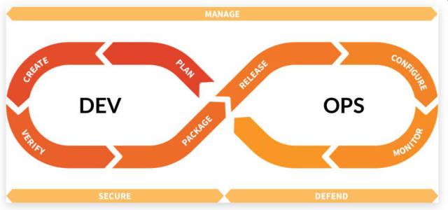
Introduction – Project Definition
Project Definition
Configuration
→ Combination of all artifacts of a system
→ HW, SW, Parameter, etc.
→ Valid at a given point in time
→ Responsible for operation, safety & security
Configuration Management
→ Management discipline
→ Controlling and tracking of configurations
Figure 2 – CM Life Cycle (GitLab.com)
CM Objectives
→ Traceability
→ Integrity
→ Comparability
→ Recovery
A. Holzmann, M. Kamm, M. Wager – Winter Semester 2020/21
Notes:
1:00

Slide 5
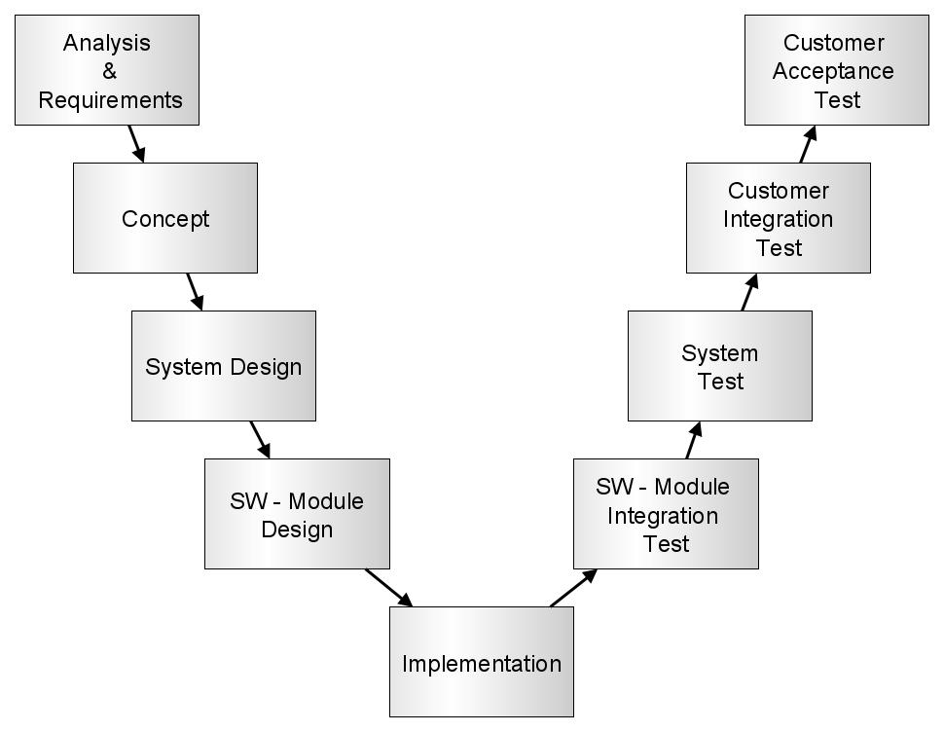
Introduction – V-Model Process
V-Model Process
Structured approach
CM development aligned to V-Model process
CM functionality aligned to V-Model process
Figure 3 – Development V-Model Process
A. Holzmann, M. Kamm, M. Wager – Winter Semester 2020/21

Slide 6
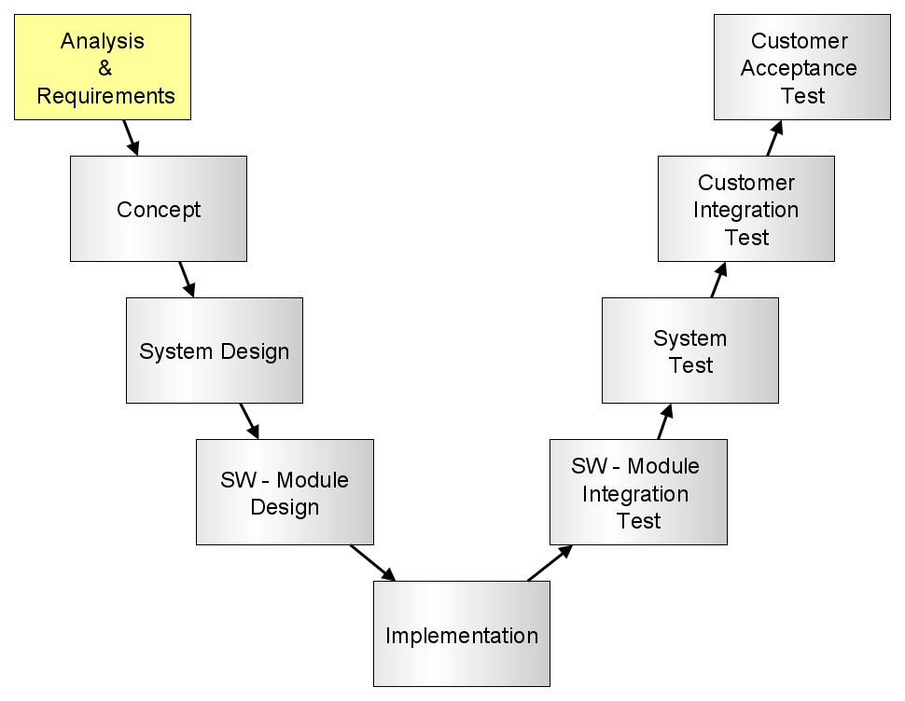
Analysis Phase
Analysis Phase
Infrastructure Analysis
Risk Assessment & Mitigations
Requirements Specification
A. Holzmann, M. Kamm, M. Wager – Winter Semester 2020/21

Slide 7
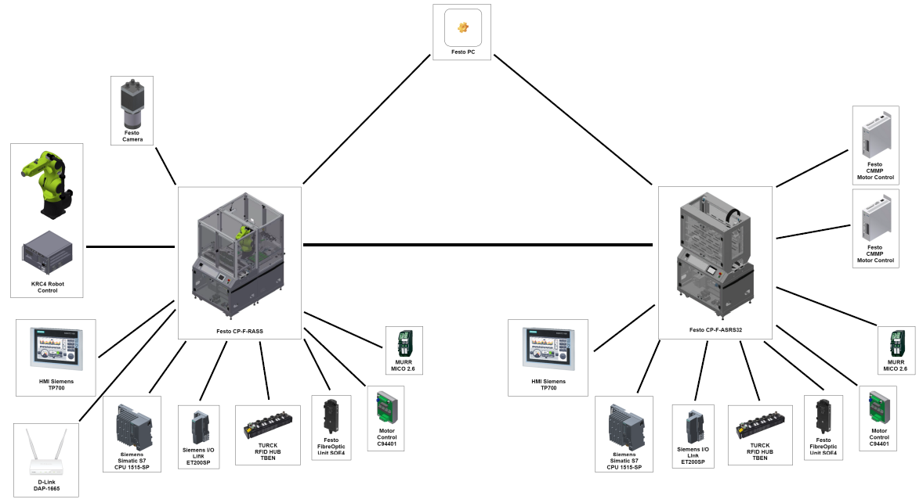
Analysis Phase – Infrastructure Analysis
Infrastructure Analysis
Figure 4 – Production Facility Lab H4.12
A. Holzmann, M. Kamm, M. Wager – Winter Semester 2020/21

Slide 8
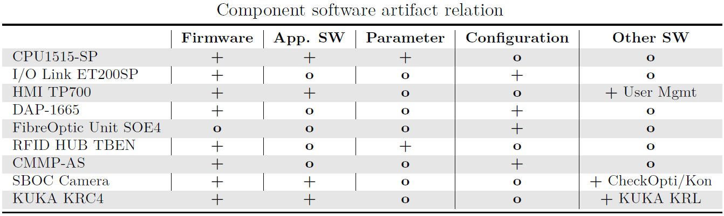
Analysis Phase – Infrastructure Analysis
Infrastructure Analysis
Hardware Infrastructure
Production Cells (CP-F-RASS-KUKA, CP-F-ASRS32)
Control & monitoring components (e.g. Siemens Simatic S7, KUKA Robot)
Passive components (Wiring, Mechanics)
Software Infrastructure
Figure 5 – Software Overview
A. Holzmann, M. Kamm, M. Wager – Winter Semester 2020/21

Slide 9
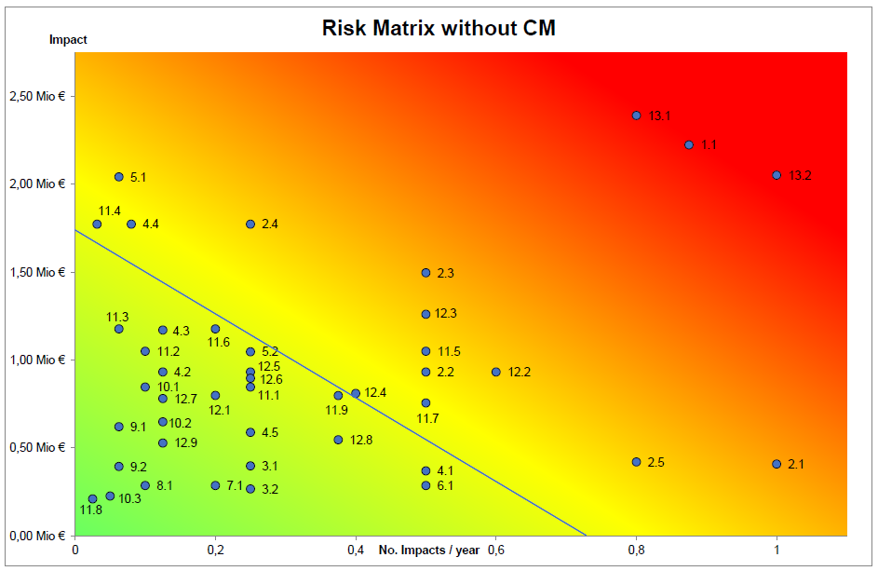
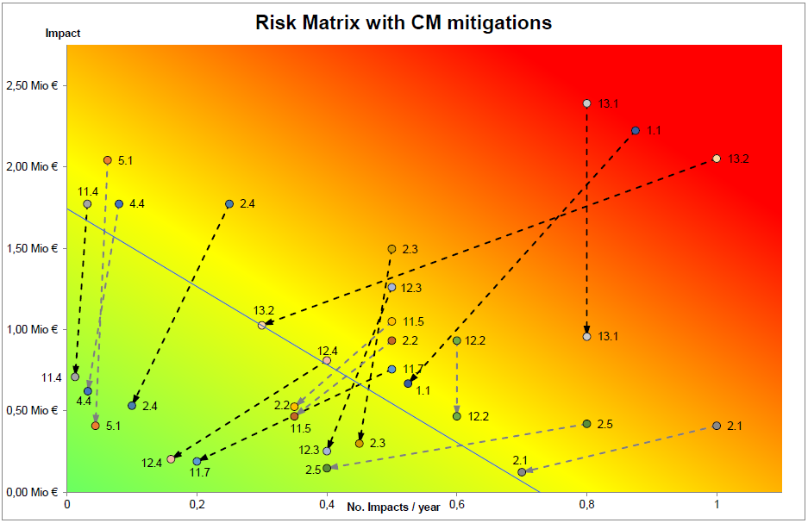
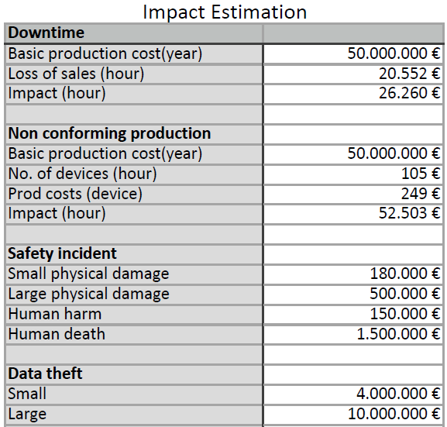
Analysis Phase – Risk Assessment
Risk Assessment
Step 1 - Risk Identification
→ 43 Assets
Step 2 - Risk Analysis
Step 3 - Risk Evaluation
Figure 6 – Impact Estimation Calculation Base
Figure 7 – Risk Matrix
A. Holzmann, M. Kamm, M. Wager – Winter Semester 2020/21
Notes:
1:30

Slide 10
Analysis Phase – Risk Assessment
Risk Assessment - Relevant Mitigations
→ Mitigations cover multiple assets
• MIT1: Automatic firmware version logging
• MIT2: Automatic application version logging
• MIT3: Detection and logging of unauthorized artifact changes
• MIT4: Comprehensive development process
• MIT5: Detection and logging of parameter changes
• MIT6: Hardware infrastructure design modification tracking
• MIT7: Implementation of computer aided spare part replacement process
A. Holzmann, M. Kamm, M. Wager – Winter Semester 2020/21
Notes:
0:30

Slide 11
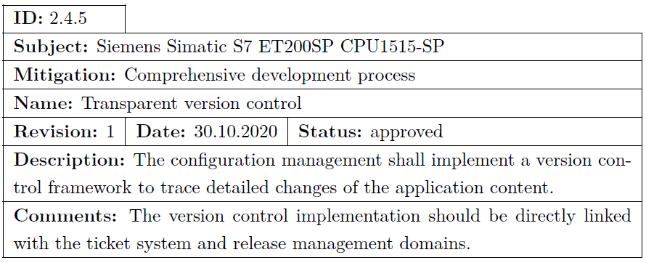
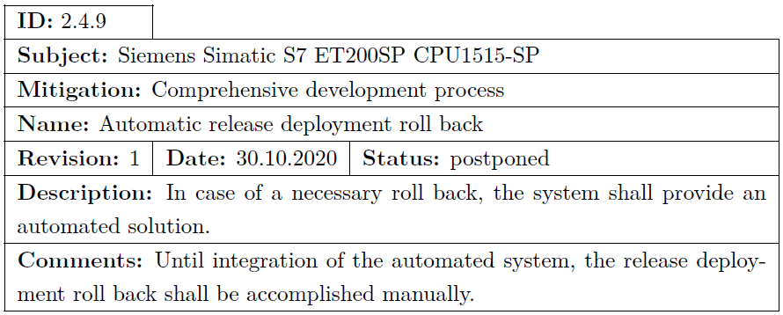
Analysis Phase – Requirements Specification
Requirements Specification
Quantity: ~300 requirements
Non-functional & functional requirements
System and Software Requirements Specification
Each Requirement contains:
• a unique identifier (ID) related to the corresponding risk
• a subject representing the component of the system
• a mitigation action title
• the requirements name
• a revision number for document version control
• a creation date
• a status indicating the approval state
• a description containing the actual requirement details
• a field for additional comments
Figure 8 – Requirements Specification Excerpt
A. Holzmann, M. Kamm, M. Wager – Winter Semester 2020/21
Notes:
1:00

Slide 12
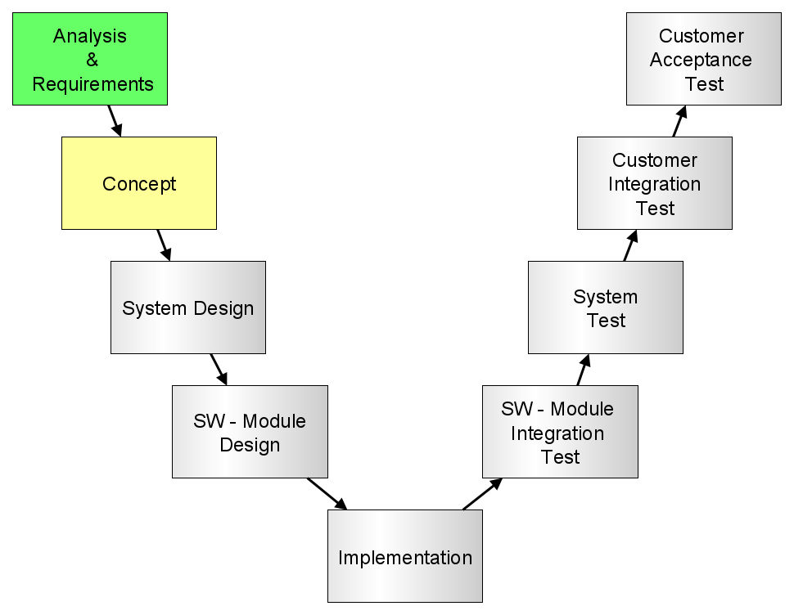

Concept Phase
Concept Phase
Top level architecture design approach
Abstract structure of functionality
Actor roles:
Administrator
Release Manager
Service Engineer
Developer
Maintenance Engineer
Concept Mitigations:
MIT1 & MIT2
MIT3
MIT4 & MIT6
MIT5
MIT7
flaticon.com
Figure 9 – Team CM
A. Holzmann, M. Kamm, M. Wager – Winter Semester 2020/21

Slide 13
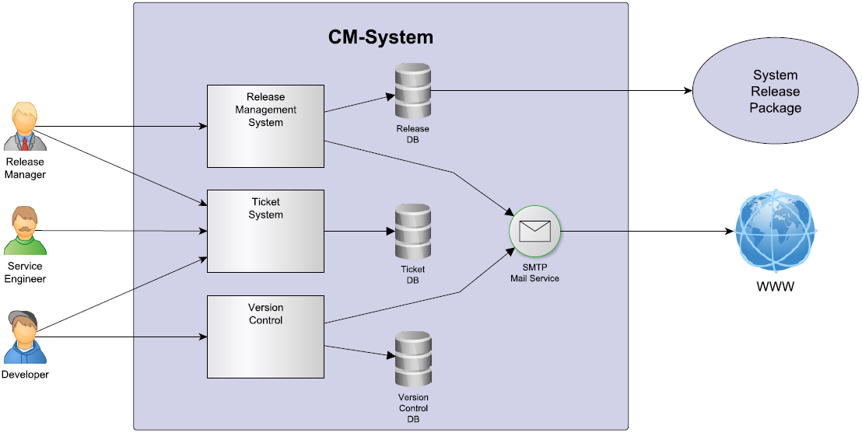
Concept Phase – MIT4 & MIT6
MIT4 & MIT6 – Comprehensive Development Process
Figure 10: MIT4 & MIT6 - Architecture Concept
A. Holzmann, M. Kamm, M. Wager – Winter Semester 2020/21

Slide 14
Concept Phase – MIT4 & MIT6
MIT4 & MIT6 – Comprehensive Development Process
Mitigation objectives:
Development life-cycle monitoring
Transparent development documentation
Development history traceability
Ticket state change email notification
Source code transparency
Implementation history traceability
Release planning
Release life-cycle monitoring
Release build process
Release history traceability
Release email notification
Figure 11: Development Process
A. Holzmann, M. Kamm, M. Wager – Winter Semester 2020/21

Slide 15
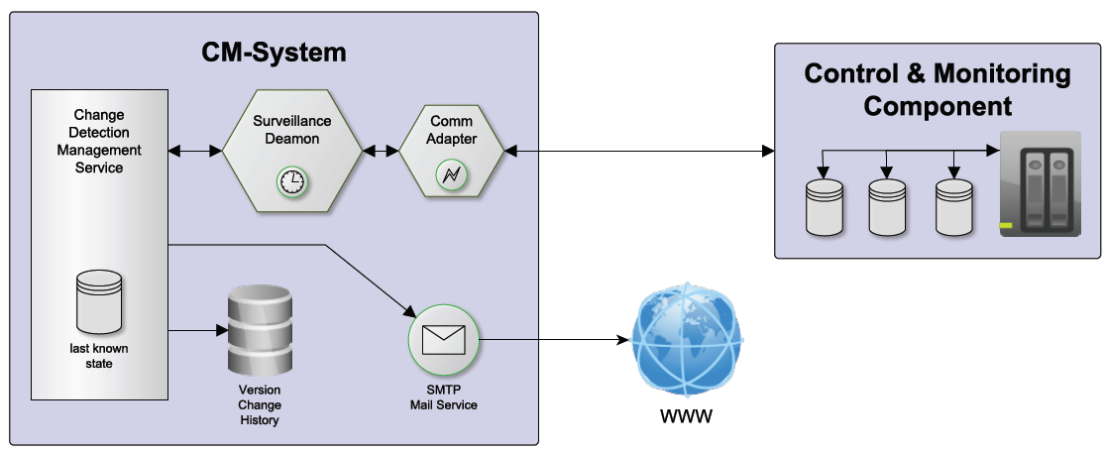
Concept Phase – MIT1 & MIT2 MIT3, MIT5
MIT1 & MIT2, MIT3, MIT5 – Continuous Change Surveillance
Figure 12: MIT1 & MIT2, MIT3, MIT5 - Architecture Concept
A. Holzmann, M. Kamm, M. Wager – Winter Semester 2020/21

Slide 16

Concept Phase – MIT1, MIT2, MIT3, MIT5
MIT1 & MIT2: Automatic firmware & application version logging
MIT3: Detection and logging of unauthorized artifact changes
MIT5: Detection and logging of unauthorized parameter changes
Mitigation Objectives:
Data Acquisition
Change Detection
Persistent History Storage
Event Notification
flaticon.com
A. Holzmann, M. Kamm, M. Wager – Winter Semester 2020/21

Slide 17
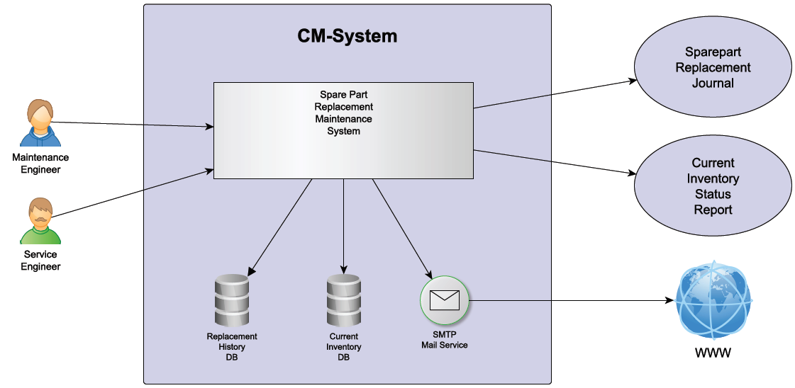
Concept Phase – MIT7
MIT7 – Computer Aided Spare Part Replacement Process
Figure 13: MIT7 - Architecture Concept
A. Holzmann, M. Kamm, M. Wager – Winter Semester 2020/21

Slide 18

Concept Phase – MIT4 & MIT6
MIT7 – Computer Aided Spare Part Replacement Process
Mitigation objectives:
Easy accessibility & guided usability
Persistent storage of replacement task
Update of persistent inventory database
Spare part replacement email notification
Maintenance task report
Spare part replacement journal
Inventory status report
flaticon.com
A. Holzmann, M. Kamm, M. Wager – Winter Semester 2020/21

Slide 19
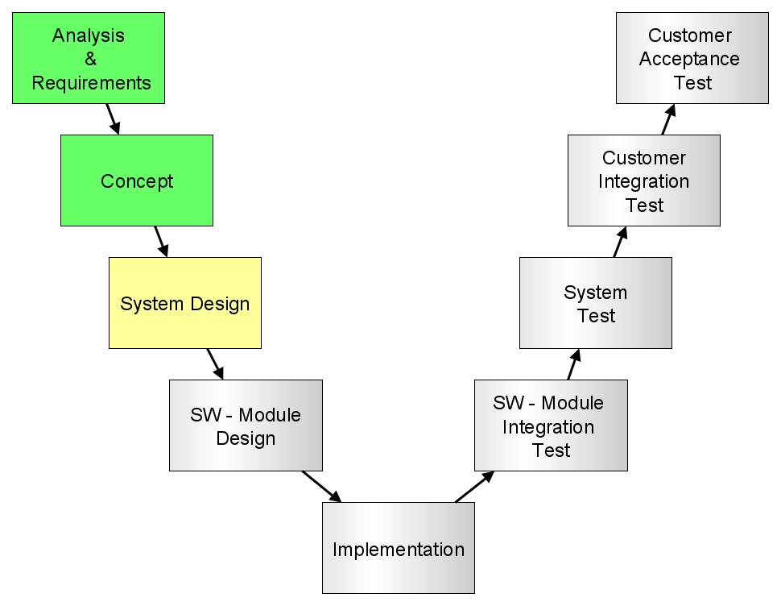
Design Phase
Design Phase
Tool Research
Freely available
Suitable for integration within CM system
Future proof extensibility
8 criteria for evaluation & selection
Architecture Description
software architecture design
Integration level perspective (service oriented)
Actors and Interfaces
Component network interconnection structure
Functional Specification
Description of the functional use cases
Designed Mitigations:
→ MIT4 & MIT6
→ MIT3
→ MIT7
A. Holzmann, M. Kamm, M. Wager – Winter Semester 2020/21
Notes:
INTRO FIRST
Überleitung von Concept auf Design

Slide 20
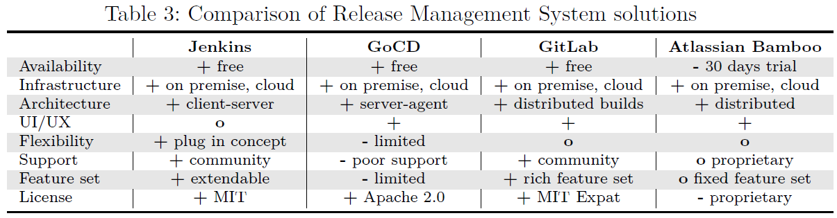
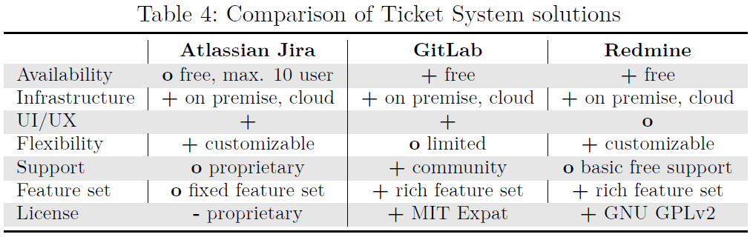
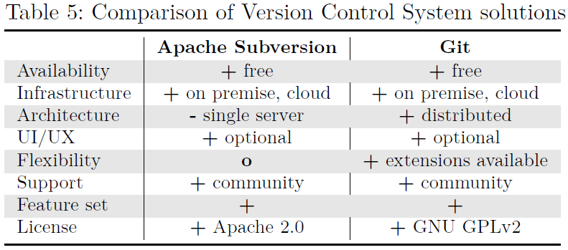
Design Phase - MIT4 & MIT6 - Comprehensive Development Process
MIT4 & MIT6 – Tool Research
Release Management Framework
Ticket System Solution
Version Control System
Figure 14 – Tool Research Tables
A. Holzmann, M. Kamm, M. Wager – Winter Semester 2020/21

Slide 21
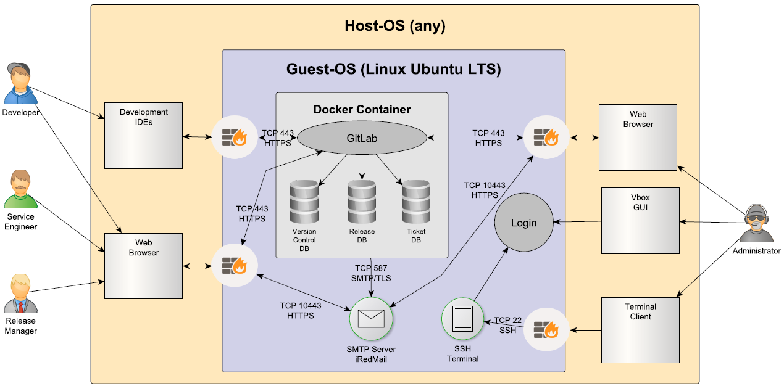
Design Phase - MIT4 & MIT6 - Comprehensive Development Process
MIT4 & MIT6 – Software Architecture Description
Figure 15 – MIT4 & MIT6 Software Architecture
A. Holzmann, M. Kamm, M. Wager – Winter Semester 2020/21
Notes:
DECIDED for heavy VIRT. solution
-> Portability
-> Maintainability
-> Security

Slide 22
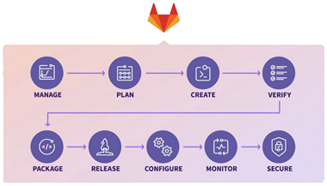
Design Phase - MIT4 & MIT6 - Comprehensive Development Process
MIT4 & MIT6 – Functional Specification
Release Management
Release Project Definition
Release Planning
Progress Monitoring
Release Approval Process
Release History Tracking
Ticket System
Development life-cycle
Role based user control
Linked to Release Management
Version Control
File granular traceability of changes
History based persistent storage of content
Linked to Ticket System
gitlab.com
Figure 16 – GitLab Life-Cycle
A. Holzmann, M. Kamm, M. Wager – Winter Semester 2020/21
Notes:
Tickets (open/close) -> Release Management

Slide 23
Design Phase - MIT3 - Detection and Logging of Unauthorized Artifact Changes
MIT3 – Tool Research
JavaScript (node.js environment)
Flexible & portable
Dynamically typed scripting language
Comprehensive library support
Native library support (various prog. languages)
GitLab Framework
Already implemented and installed with MIT4 & MIT6
All requirements fulfilled
A. Holzmann, M. Kamm, M. Wager – Winter Semester 2020/21
Notes:
JavaScript is widely used, simple to use, dynamically typed
scripting language, offering comprehensive library support (e.g. GitLab, OPC-UA,
Logging, ...).

Slide 24
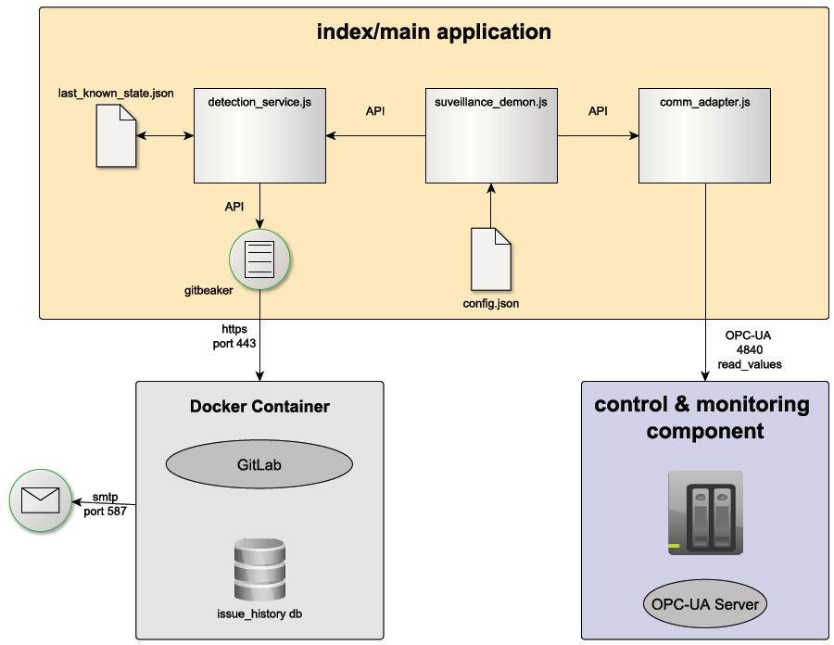
Design Phase - MIT3 - Detection and Logging of Unauthorized Artifact Changes
MIT3 – Software Architecture Description
Figure 17 – MIT3 Software Architecture
A. Holzmann, M. Kamm, M. Wager – Winter Semester 2020/21

Slide 25
Design Phase - MIT3 - Detection and Logging of Unauthorized Artifact Changes
MIT3 – Functional Specification
Main Application
Surveillance (scheduling & detection) logic
Communication with control & monitoring components (HW)
Tracking of “last known states”
Global service configuration
Communication with GitLab REST API
GitLab Service
Persistent history storage
Email notification service
A. Holzmann, M. Kamm, M. Wager – Winter Semester 2020/21

Slide 26
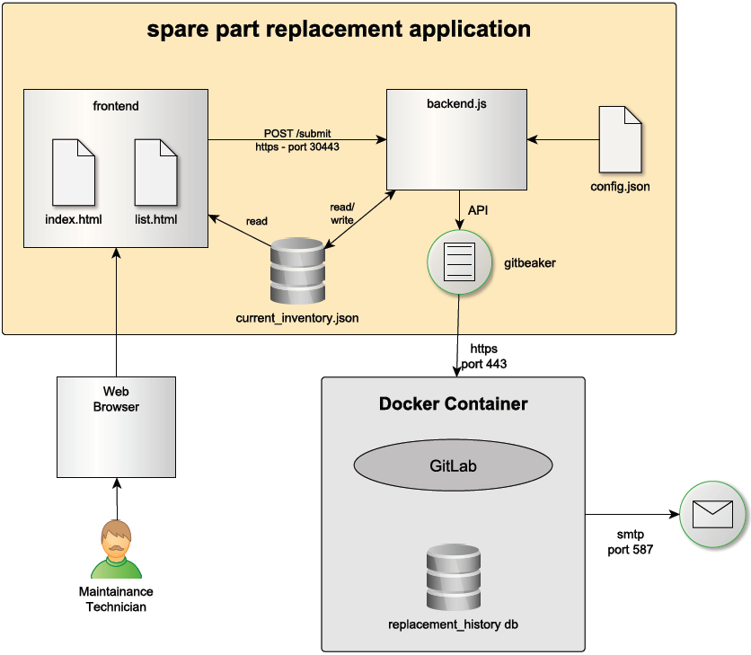
Design Phase – MIT7 - Computer Aided Spare Part Replacement Process
MIT7 – Software Architecture Description
Figure 18 – MIT7 Software Architecture
A. Holzmann, M. Kamm, M. Wager – Winter Semester 2020/21

Slide 27
Design Phase – MIT7 - Computer Aided Spare Part Replacement Process
MIT7 – Functional Specification
Spare Part Replacement Application
HTTPS webserver for frontend access
Frontend
Guided replacement form
Current inventory history table
Backend
Form submit validation
Persistent tracking of “current inventory database”
Global service configuration
Communication with GitLab REST API
GitLab Service
Persistent history storage
Email notification service
A. Holzmann, M. Kamm, M. Wager – Winter Semester 2020/21

Slide 28
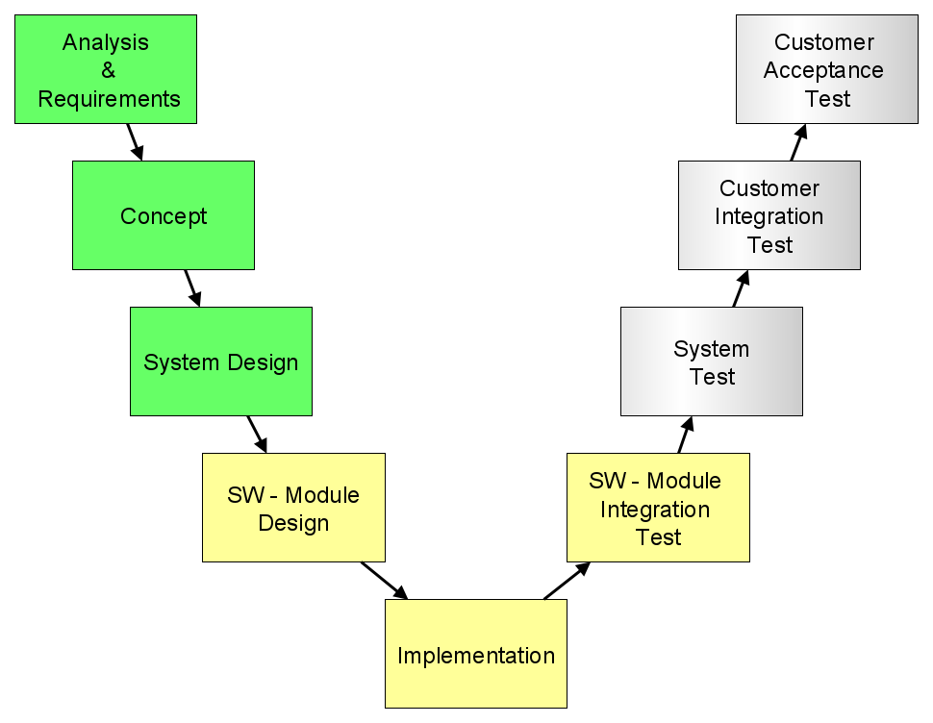
Implementation Phase
Implementation Phase
Environment setup
Installation
Configuration
Network infrastructure setup
Programming
Application & service code
Communication adapter code
Runtime management scripting
Testing
Module- and integration tests
Development environment
Implemented Release Candidates:
→ RC1: MIT4 & MIT6
→ RC2: MIT3, MIT7
A. Holzmann, M. Kamm, M. Wager – Winter Semester 2020/21
Notes:
1:00
RCs for intermediate delivery
Only some excerpts, complete desc in Report

Slide 29
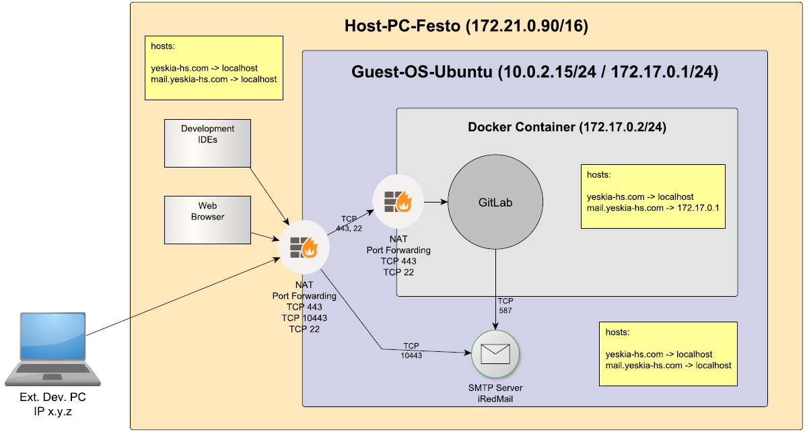
Implementation Phase - MIT4 & MIT6 - Comprehensive Development Process
RC1 – Network infrastructure setup
Firewall
Network Address Translation (NAT)
Filter (access only for required ports)
Virtual Box Port Forwarding
Host-PC requests hooking and forwarding
Localhost
Remote accessible IP-Address
Fully Qualified Domain Names (FQDN)
Local DNS resolving
Docker Container
Guest-OS
Host-PC
Figure 19 – MIT4 & MIT6 Nework infrastructure
A. Holzmann, M. Kamm, M. Wager – Winter Semester 2020/21
Notes:
1:15

Slide 30
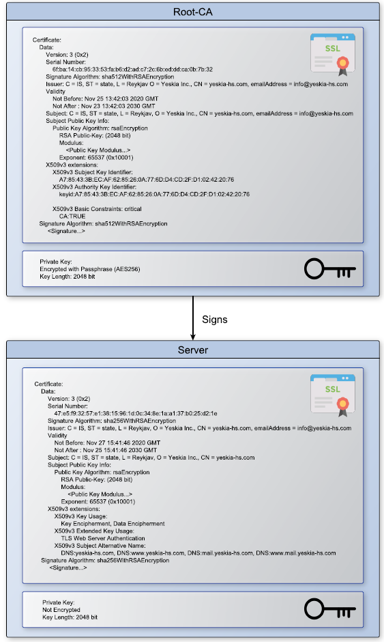
Implementation Phase - MIT4 & MIT6 - Comprehensive Development Process
RC1 – Certificate Authority
Root CA certificate
Self-signed (Yeskia Inc.)
Private key encrypted (AES256)
Used for signing intermediate and end-user certificates
Public certificate installed to client certificate stores (e.g. web browser)
Server certificate
Signed by root-CA (Yeskia Inc.)
Identification for all CM server entities
Configuration
IETF X.509 v3
OpenSSL toolchain
Valid until 2030
Replaceable by IT-department certificates
Figure 20 – Certificate Authority
A. Holzmann, M. Kamm, M. Wager – Winter Semester 2020/21
Notes:
0:45

Slide 31
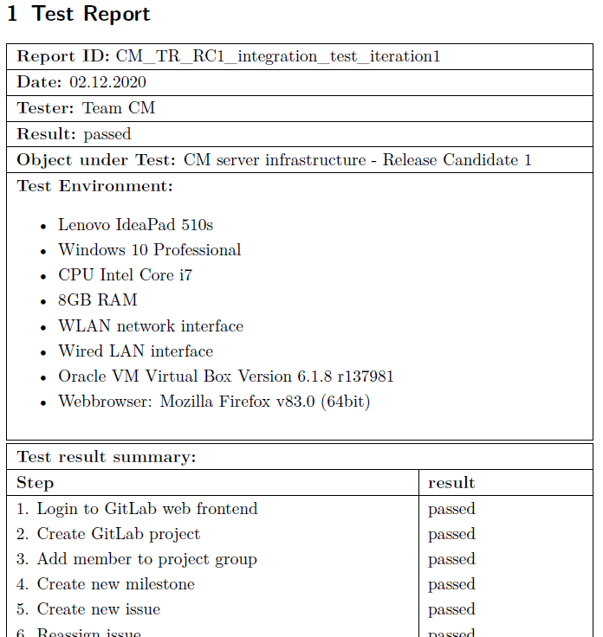
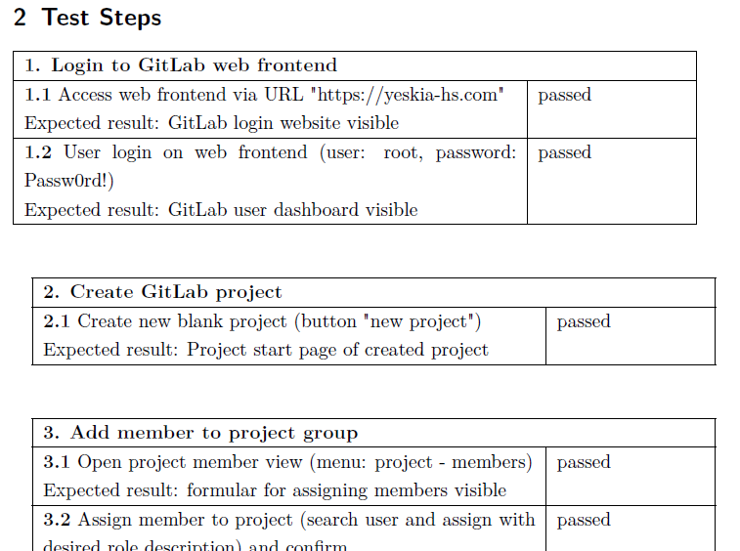
Implementation Phase - MIT4 & MIT6 - Comprehensive Development Process
RC1 – Integration Test
Figure 21 – Test Report Excerpt
A. Holzmann, M. Kamm, M. Wager – Winter Semester 2020/21
Notes:
0:30

Slide 32
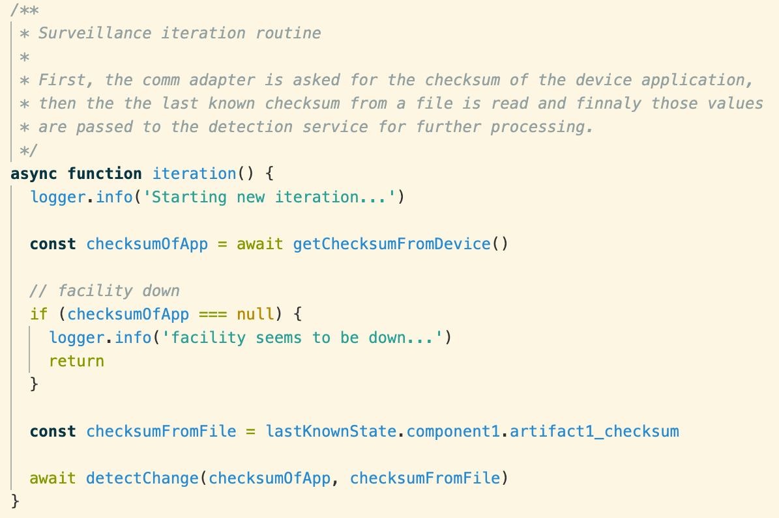
Implementation Phase - MIT3 - Detection and Logging of Unauthorized Artifact Changes
RC2/1 – Implementation
Surveillance Deamon
Scheduling logic
Runtime task context
iteration()
Communication Adapter
OPC/UA protocol
Connection to Simatic S7 SPS
getChecksumFromDevice()
Detection Service
Change detection algorithm
detectChange(checksumOfApp, checksumFromFile)
Figure 22 – MIT3 Surveillance Iteration Loop
A. Holzmann, M. Kamm, M. Wager – Winter Semester 2020/21

Slide 33
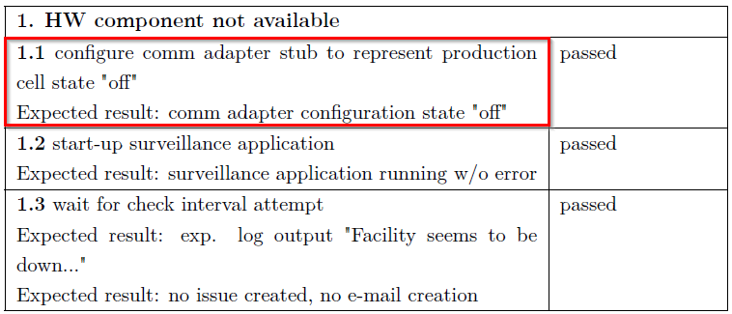
Implementation Phase - MIT3 - Detection and Logging of Unauthorized Artifact
RC2/1 – Integration Test
Stubbed environment
No hardware components available at developer site
Stubbed comm_adapter module implementation
Emulating real communication with the control & monitoring device
Simulation of all relevant use-cases
→ Typical scenario in modern system/software development
Figure 23 – Test Report Excerpt
A. Holzmann, M. Kamm, M. Wager – Winter Semester 2020/21

Slide 34
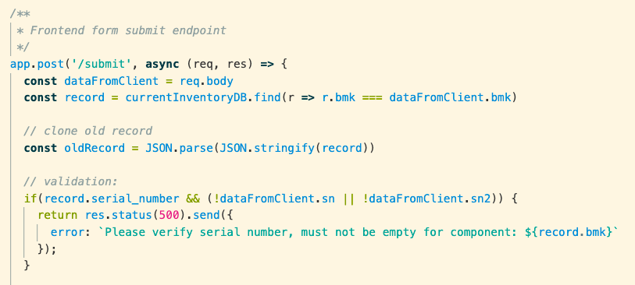
Implementation Phase – MIT7 - Computer Aided Spare Part Replacement Process
Changes
RC2/2 – Implementation & Integration Test
Webserver
Scheduling logic
Runtime task context
iteration()
Frontend
Bootstrap Framework
HMTL5
Backend
GitLab connection config file
JSON inventory database
Webserver HTTPS
(Yeskia Inc. CA – server certificate)
Figure 24 – MIT3 Surveillance Iteration Loop
→ Integration test specification and protocol available
A. Holzmann, M. Kamm, M. Wager – Winter Semester 2020/21

Slide 35
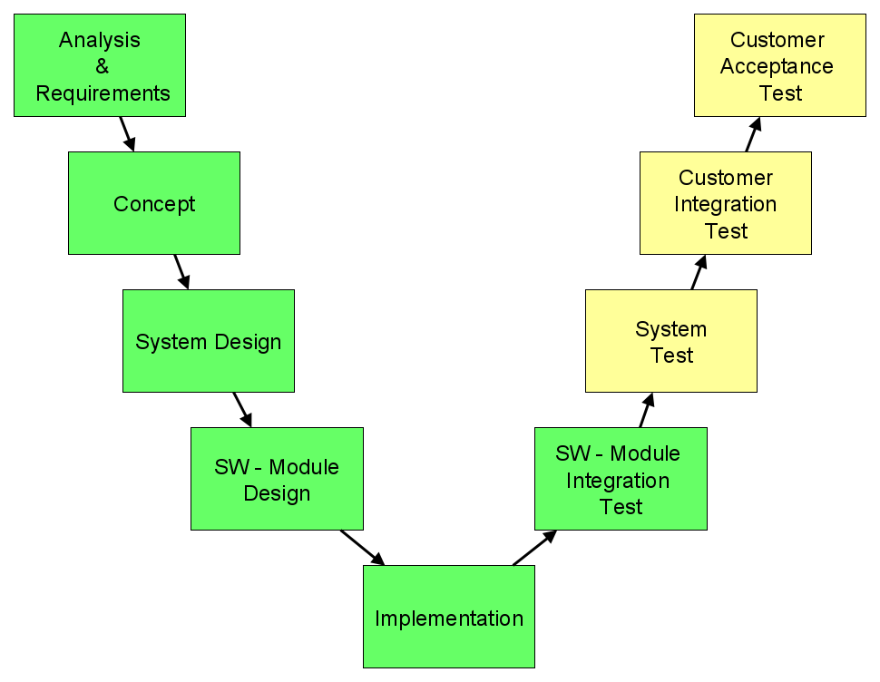
Validation Phase
Validation Phase
System Integration Test
Laboratory environment
Partial infrastructure available
Customer Integration Test
Installation and test at customer site
Full infrastructure available
Customer Acceptance Test
Final validation step
Customer responsible for final approval
Test Specification
Documentation of test setup, environment and detailed test steps
Test Procedure
Documentation of the test execution and corresponding results
A. Holzmann, M. Kamm, M. Wager – Winter Semester 2020/21

Slide 36
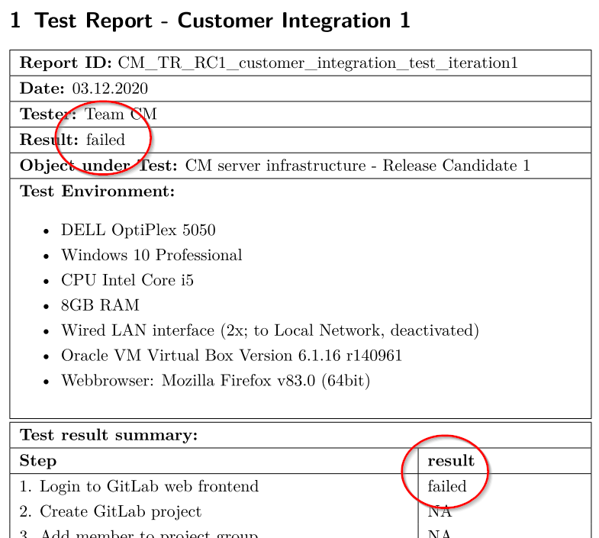
Validation Phase – MIT4 & MIT6 (RC1)
Changes
RC1 – Customer Integration Test
Test iteration 1:
Failed at step 1
Port conflict with customer server env.
Further test execution skipped
→ Troubleshooting and correction
Test iteration 2:
Test passed (all steps)
→ Each test phase is important for success
Figure 25 – Test Protocol Excerpt
A. Holzmann, M. Kamm, M. Wager – Winter Semester 2020/21
→ Integration test specification and protocol available

Slide 37
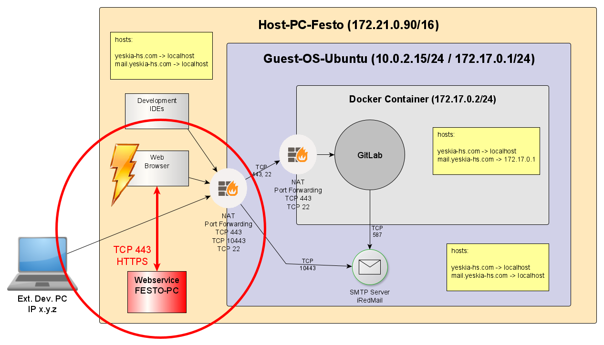
Validation Phase – MIT4 & MIT6 (RC1)
Changes
RC1 – Customer Integration Test
Figure 26 – RC1 Customer Integration Test Fail
A. Holzmann, M. Kamm, M. Wager – Winter Semester 2020/21

Slide 38
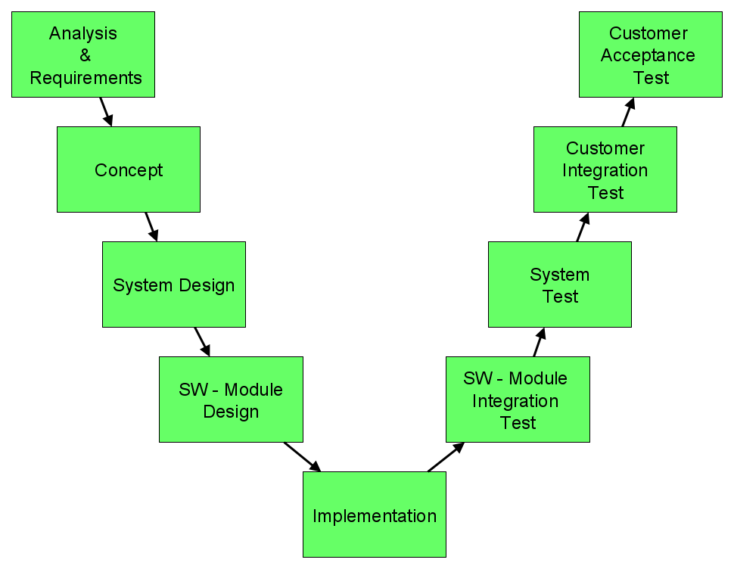
Summary & Outlook
- MIT4 & MIT6 - Comprehensive Development Process
Summary
Project Setup
Project definition
Development environment & infrastructure
(Tooling, GIT, Templates, etc.)
Project Management
Project plan (GANTT)
Project coordination
Project progress monitoring
Status reports, deviation agreements
Project Structure & Result
V-Model process
Consistent project approach
Project objectives achieved / CM server infrastructure established
Solutions address most critical risks of Yeskia Inc. (high mitigation effect)
A. Holzmann, M. Kamm, M. Wager – Winter Semester 2020/21
Notes:
1:30

Slide 39

Summary & Outlook
- MIT4 & MIT6 - Comprehensive Development Process
Outlook
Continuous increase of system complexity
Configuration Management mandatory for Security and Safety
Industrial Sector → Lack of Configuration Management
Project covers basic implementation
provides solid foundation for future projects
→ Configuration Management complex and expensive,
huge potential within production environments
gitlab.com
A. Holzmann, M. Kamm, M. Wager – Winter Semester 2020/21
Notes:
1:30
Project continuation, docu available, modular, portable,

Slide 40
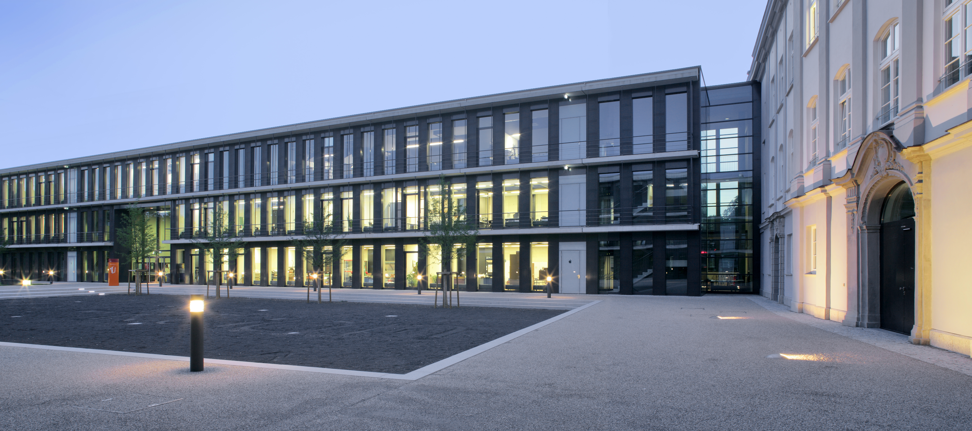
Thank you for your attention
Alexander.Holzmann@hs-augsburg.de
Markus.Kamm@hs-augsburg.de
Michael.Wager@hs-augsburg.de
Notes:
Vielen Dank für Ihre Aufmerksamkeit
Gerne bei Interesse kontaktieren
Der Bereich ist und bleibt sehr spannend…

